Slide 1
ADA BOOST ALGORITHM

Slide 2
AdaBoost (Adaptive Boosting) is a powerful ensemble machine learning algorithm that combines multiple simple "weak learners" (like shallow decision trees, or "stumps") sequentially to create one strong, accurate "strong learner" for classification or regression, primarily by focusing on errors

Slide 3
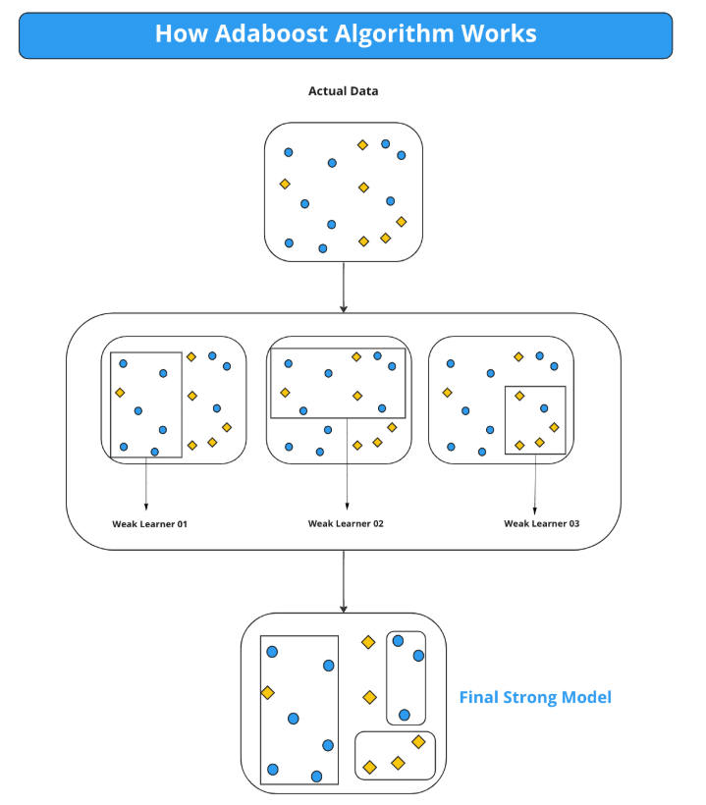

Slide 4
How AdaBoost Works (The Core Idea)
Initial Weights: All data points start with equal importance (weight).
Sequential Training: A "weak" model (stump) is trained to classify the data.
Error Focus: The algorithm calculates which points were misclassified and increases the weights of those errors.
Adaptation: The next stump is trained to pay more attention to these higher-weighted, previously misclassified points.
Weighted Voting: Each weak learner's prediction is combined using a weighted vote, giving more influence to better-performing models.
Strong Learner: This iterative process of learning from mistakes builds a robust final model.

Slide 5
